Slide 1
Java BufferedReader class
The Java BufferedReader class (java.io.BufferedReader) provides buffering to your Reader instances. Buffering can speed up IO quite a bit. Rather than read one character at a time from the network or disk, the BufferedReader reads a larger block at a time. This is typically much faster, especially for disk access and larger data amounts.
The Java BufferedReader is similar to the BufferedInputStream but they are not exactly the same. The main difference between BufferedReader and BufferedInputStream is that BufferedReader reads characters (text), whereas the BufferedInputStream reads raw bytes.
The Java.io.BufferedReader class reads text from a character-input stream, buffering characters so as to provide for the efficient reading of characters, arrays, and lines. Following are the important points about BufferedReader:
The buffer size may be specified, or the default size may be used.
In general,Each read request made of a Reader causes a corresponding read request to be made of the underlying character or byte stream. It is therefore advisable to wrap a BufferedReader around any Reader whose read() operations may be costly, such as FileReaders and InputStreamReaders.
FileReader
Buffer
BufferedReader
uses
myinputfile.txt
Java Application
Read
Read
Peter is going to India

Slide 2
Java BufferedReader class
To add buffering to a Reader instance, simply wrap it in a BufferedReader.
This example creates a BufferedReader which wraps a FileReader. The BufferedReader will read a block of characters from the FileReader (typically into a char array). Each character returned from read() is thus returned from this internal array. When the array is fully read the BufferedReader reads a new block of data into the array etc.
BufferedReader bufferedReader = new BufferedReader( new FileReader("c:\\data\\myinputfile.txt "));

Slide 3
Java BufferedReader class
You can set the buffer size to use internally by the BufferedReader. You provide the size as a constructor parameter, like below.
This example sets the internal buffer to 8 KB. It is best to use buffer sizes that are multiples of 1024 bytes. That works best with most built-in buffering in hard disks etc.
Except for adding buffering to Reader instances, a Java BufferedReader behaves pretty much like a Reader. The BufferedReader has one extra method though, the readLine() method. This method can be handy if you need to read input one line at a time.
The readLine() method will return a textual line (all text until at line break is found) read from the BufferedReader. If there is no more data to read from the underlying Reader, then the BufferedReader's readLine() method will return null .
When you are finished reading characters from the BufferedReader you should remember to close it. Closing a BufferedReader will also close the Reader instance from which the BufferedReader is reading.
int bufferSize = 8 * 1024;
BufferedReader bufferedReader = new BufferedReader( new FileReader("c:\\data\\myinputfile.txt", bufferSize );
String line = bufferedReader.readLine();
bufferedReader.close();

Slide 4
Java BufferedReader class
Reader
BufferedReader

Slide 5
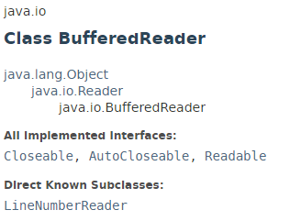
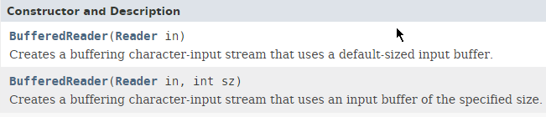
Java BufferedReader class

Slide 6
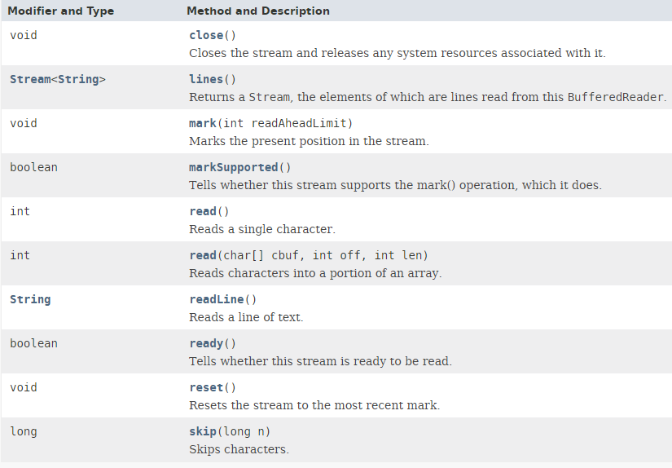
Java BufferedReader class

Slide 7
Java BufferedReader class
https://docs.oracle.com/javase/8/docs/api/index.html?java/io/BufferedReader.html

